Slide 1
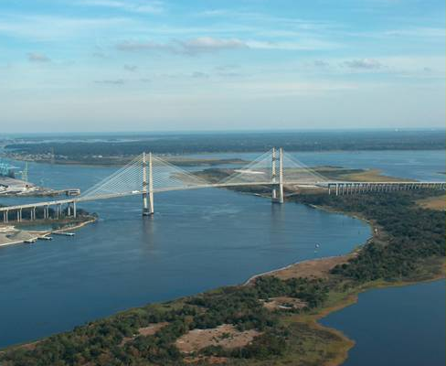
STATE OF THE RIVER REPORT 2011
FOR THE LOWER ST. JOHNS RIVER BASIN:
WATER QUALITY, FISHERIES, AQUATIC LIFE,
CONTAMINANTS, and AQUATIC TOXICOLOGY
Jacksonville University
University of North Florida
Radha Pyati, Ph.D. (UNF)
Lucinda Sonnenberg, Ph.D (JU)
Notes:
Thank you for that introduction.
Good afternoon
It is my pleasure to present to you today the
State of the River Report 20011for the Lower St. Johns River Basin, Florida:
Water Quality, Fisheries, Aquatic Life, and Contaminants.
1

Slide 2
Origins of the State of the River Report
Purpose
to inform the public about health of the Lower St. Johns River Basin, Florida (LSJRB).
Funding
Environmental Protection Board (EPB) of City of Jacksonville
Jacksonville City Council
River Branch Foundation
History
2012 marks the fifth year of the State of the River Report.
2
Notes:
The State of the River Report was funded by the City of Jacksonville through the Environmental Protection Board with support of the Mayor’s Office and City Council to inform the public about health of the Lower St. Johns River Basin, Florida (LSJRB).
It is one component of a range of far-reaching efforts initiated by Jacksonville Mayors John Delaney and John Peyton and the River Accord partners to inform the public about health of the Lower St. Johns River Basin, Florida (LSJRB).
2

Slide 3
Topical Coverage of the Report
The report describes the health of the Lower St. Johns River Basin based on a number of broad indicators.
WATER QUALITY
FISHERIES
AQUATIC LIFE
CONTAMINANTS
AQUATIC TOXICOLOGY
How each indicator contributes to, or signals, overall river health is discussed in terms of its current status in 2012 and trends over time.
3
Notes:
The report describes the health of the Lower St. Johns River Basin based on a number of broad “health” indicators (33 Total).
These include indicators associated with water quality, such as nutrients, turbidity, and Dissolved Oxygen.
indicators associated with fisheries, such as the number of commercially landed blue crabs or spotted seatrout.
Aquatic life such as submerged aquatic vegetation, wetlands, & threatened and endangered species, to name a few.
Finally…contaminants found in sediments, such as metals & PCBs.
Data were amassed and assessed from previously collected research.
Indicators are discussed in terms of current status (satisfactory---unsatisfactory---uncertain) through 2008,
and trends over time (such as conditions improving, conditions stable, conditions worsening, or or uncertain).
3

Slide 4
Five Components of the Report
Full Report (with Glossary)
Appendix
Website
http://www.SJRreport.com
Brochure
Digital Archive of all references – a new feature
4
Notes:
The goal of the project was to present this data in a form that was understandable to the public.
To do this, there are four components to the report:
An 8-page brochure – defining each indicator, and summarizing the status, and trend of most of the indicators investigated.
A 100-page report – that provides background information and goes into further detail on these and additional indicators within the four major areas.
A 117-page appendix – that contains data, additional graphs, & the statistics that support the assignment of status and trends.
Finally….all this is available and downloadable on the website <<http://www.SJRreport.com>>
along with research biographies of the team members,
links to other information, and
quick links to each reference used in the study, so that you can read more.
4

Slide 5
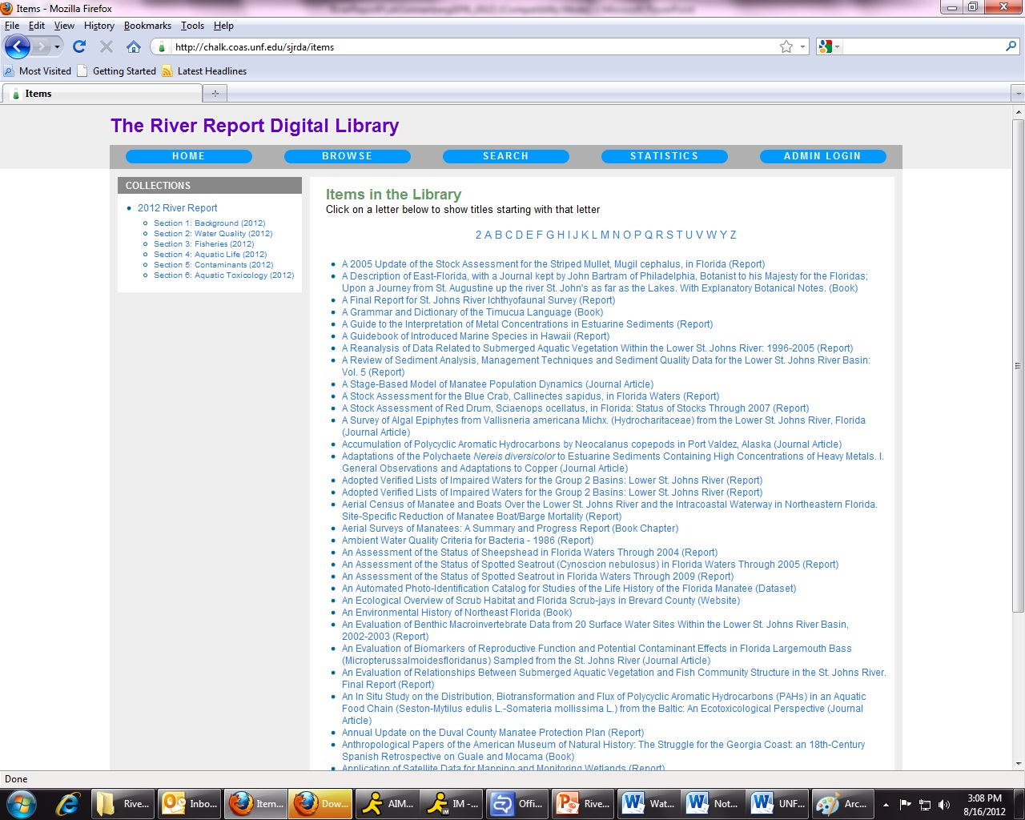
Digital Archive – Browse Page
5
Notes:
The goal of the project was to present this data in a form that was understandable to the public.
To do this, there are four components to the report:
An 8-page brochure – defining each indicator, and summarizing the status, and trend of most of the indicators investigated.
A 100-page report – that provides background information and goes into further detail on these and additional indicators within the four major areas.
A 117-page appendix – that contains data, additional graphs, & the statistics that support the assignment of status and trends.
Finally….all this is available and downloadable on the website <<http://www.SJRreport.com>>
along with research biographies of the team members,
links to other information, and
quick links to each reference used in the study, so that you can read more.
5

Slide 6
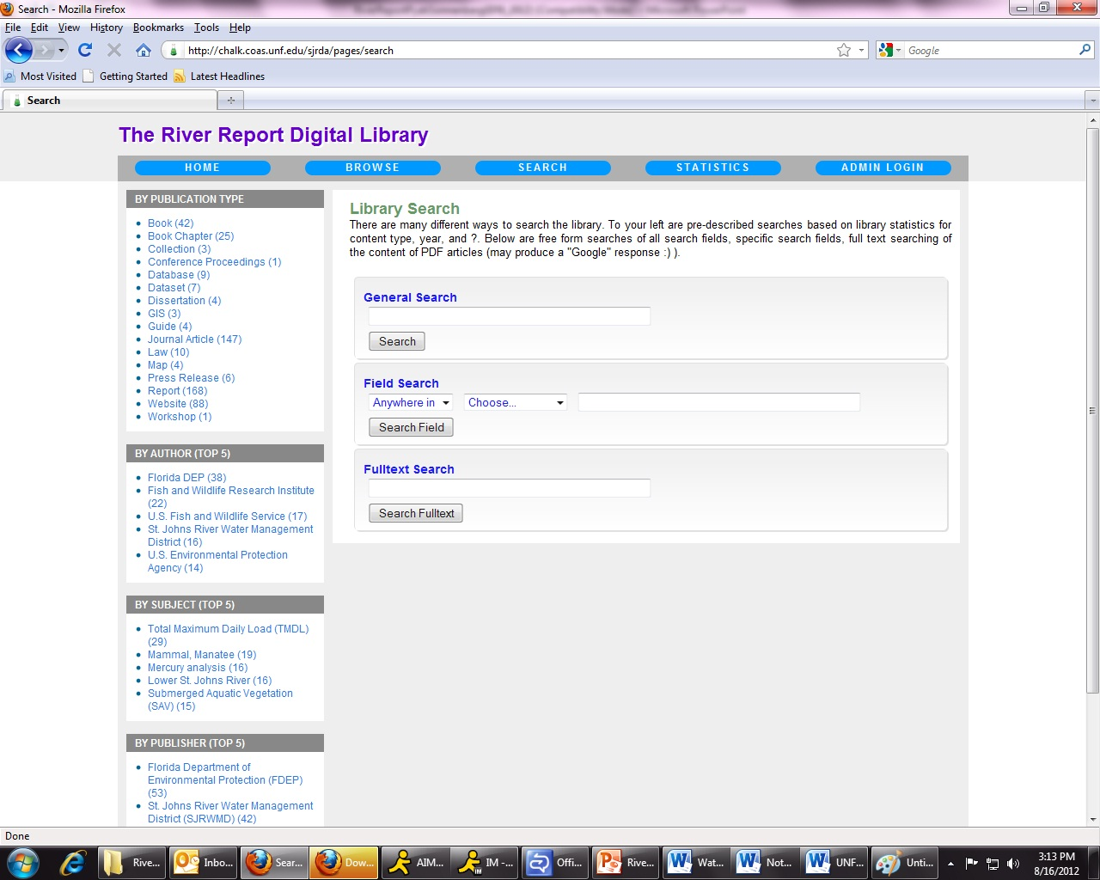
Digital Archive – Search Page
6
Notes:
The goal of the project was to present this data in a form that was understandable to the public.
To do this, there are four components to the report:
An 8-page brochure – defining each indicator, and summarizing the status, and trend of most of the indicators investigated.
A 100-page report – that provides background information and goes into further detail on these and additional indicators within the four major areas.
A 117-page appendix – that contains data, additional graphs, & the statistics that support the assignment of status and trends.
Finally….all this is available and downloadable on the website <<http://www.SJRreport.com>>
along with research biographies of the team members,
links to other information, and
quick links to each reference used in the study, so that you can read more.
6

Slide 7



Members of the Team
Daniel McCarthy, Ph. D.
Co-Principal Investigator
Fisheries & Macroinvertebrates
Lucy Sonnenberg, Ph.D.
Contaminants
Gerry Pinto, Ph.D.
Submerged aquatic vegetation & Threatened & endangered species
Heather McCarthy, M.E.M.
Background, Wetlands, Exotic Species & Brochure
Quinton White, Ph.D.
Editing & Logistics (pro bono)
Radha Pyati, Ph.D.
Co-Principal Investigator
Background & Bacteria
Pat Welsh, Ph. D.
Turbidity, Algal Blooms & Bacteria
Gretchen Bielmyer , Ph.D.
Dissolved Oxygen & Nutrients
Stuart Chalk, Ph.D.
Website , Data management & analysis
James Taylor
Document formatting
Ray Bowman, Ph.D.
Editing & Logistics (pro bono)
7
Notes:
This State of the River Report is the result of a consolidated effort directed by a team of academic researchers from Jacksonville University (JU) and the University of North Florida (UNF) in Jacksonville, Florida.
You will meet these team members as they discuss their sections in this presentation.
I would also like to acknowledge the contribution of the following people…
7

Slide 8
External Reviewers
City of Jacksonville
Vince Seibold
Dana Morton
Christi Veleta
Kristen Beach
FDEP
Donald Axelrad
Barbara Donner
Lee Banks
Patrick O’Connor
FWRI
Ted Lange
Douglas Adams
Russ Brodie
Justin Solomon
Florida Sea grant
Maia McGuire
Valdosta State
Matt Waters
SJRWMD
Dean Campbell
Charles Jacoby
John Hendrickson
John Higman
Dean Dobberfuhl
Teresa Monson
FDOH
Kendra Goff
National Park
Service
Richard
Bryant
Middlebrook
Company
Mark Middlebrook
Maria Mark
JEA
Paul Steinbrecher
St. Johns
Riverkeeper
Lisa Rinaman
Neil Armingeon
The Nature Conservancy
Mike McManus
UNF
Stephan Nix
Kelly Smith
Dale Casamatta
Wildwood
Consulting
Tiffany Busby
Marcy Policastro
Notes:
Additionally, this report has undergone an extensive review process –
including local stakeholders, and
an external review panel – with the expertise and experience in various disciplines to address the multi-faceted nature of the data.
External peer reviewers (listed here alphabetically) included –
Experts from Federal and State agencies,
local governments,
nonprofit groups ,
And numerous other stakeholders.
8

Slide 9
Water Quality
Turbidity | Main Stem: Satisfactory Tributaries: Unsatisfactory | Conditions improving
Algal Blooms | Unsatisfactory | Conditions worsening
Fecal Coliform | Main Stem: Satisfactory Tributaries: Unsatisfactory | Conditions improving
Nutrients (nitrogen and phosphorus) | Unsatisfactory | Conditions stable
Dissolved Oxygen | Unsatisfactory | Conditions stable
Metals | Unsatisfactory | Conditions improving
9

Slide 10
Water Quality
Total Phosphorus (TP)
TP versus Year for LSJR Mainstem
In 2011, dropped below 2010 levels. Maximum levels still exceed WQC.
10
Notes:
10
Algal Blooms
Probably increasing in severity
Potential toxic events
Need more data
Timing and extent
Algal type and counts

Slide 11
Water Quality
Metals
Metal concentrations have decreased in the water column over the last three years, and most values were at or below WQC in 2011.
Example below: Copper. Maximum value exceeded both saltwater and freshwater criteria.

Slide 12
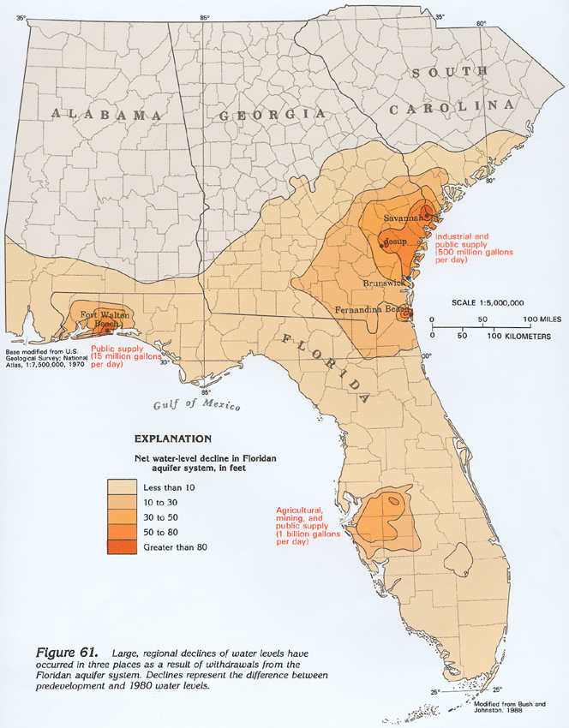
Water Quality - Groundwater
- new section
Describes Floridan Aquifer system, SJRWMD Water Supply Impact Study, potentiometric surface, and MFL program
12
Notes:
12

Slide 13
Aquatic Toxicology
- new section
Literature review of data and studies either
  gathered on SJR or
  conducted on contaminants or organisms found in SJR
Selected findings:
  Largemouth bass from LSJR found to accumulate PAHs (polycyclic aromatic hydrocarbons) in the liver; highest levels in fish from Palatka, followed by Green Cove Springs and Julington Creek
  Significant mortality to killifish occurred after exposure to copper and zinc at concentrations reported in the LSJR over the last five years
13
Notes:
13

Slide 14
[
Aquatic Life
Submerged Aquatic
Vegetation
Gerry Pinto, Ph. D.
Jacksonville University
Tape grass
Water naiad
Widgeon grass
Muskgrass
Spikerush
Horned
pondweed
Baby’s-tears
Sago pondweed
Small pondweed
Awl-leaf arrowhead
Water thyme
Significance
  Nurseries
  Food for manatees, fish, invertebrates
  Improves water quality
  Reduces erosion
Critical Conditions
  Salinity
  Water clarity
  Shoreline condition
  Epiphytes
Notes:
SAV more abundant upstream
Tape grass vallisneria most prominent in fw sections upstream sometimes in large beds, fw but tolerates brackish
Water naiad Najas commonly found, strictly fw
Widgeon grass Ruppia brackish, tolerates salty
Submerged aquatic vegetation (SAV), has experienced fairly stable levels, with variations caused by drought and increased salinity.
SAV is essential to the survival of many other aquatic species as both food and spawning area.
About 12 species, but Val.. is the dominant species.

Slide 15
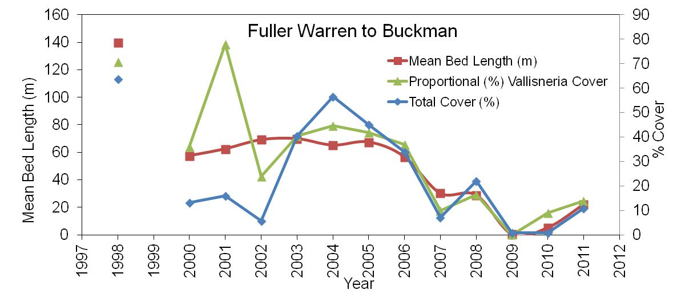
[
Aquatic Life
Submerged Aquatic
Vegetation
Data
  SJRWMD, 2000-2010
  Transects in 6 sections of LSJR
  Bed length, % total cover, % tape grass
  Aerial observations 2008-2011
Results
  Highly variable
  Decline in grass bed coverage north of the Buckman Bridge
  Higher salinity, lower % total cover and % tape grass
INDICATOR | STATUS | TREND
Submerged Aquatic Vegetation | Unsatisfactory | Conditions worsening
Notes:
Bolles school to bukcman east bank and some parts of NAS Jax to Bukman west bank but not including Mulberry Cove.
Submerged aquatic vegetation (SAV), has experienced fairly stable levels, with variations caused by drought and increased salinity.
SAV is essential to the survival of many other aquatic species as both food and spawning area.
About 12 species, but Val.. is the dominant species.

Slide 16
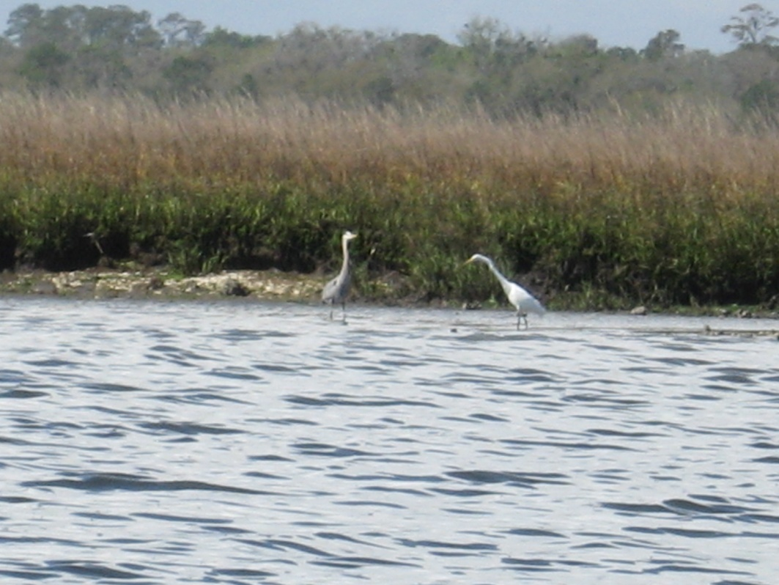
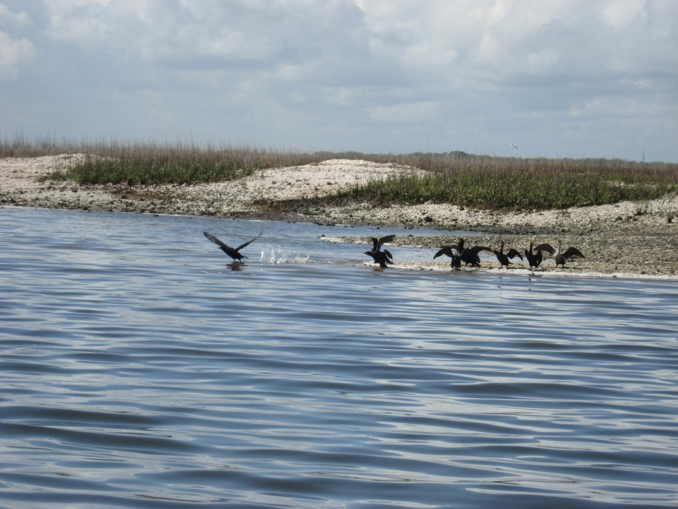
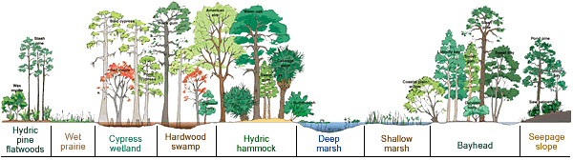
[
Aquatic Life
Wetlands
Heather McCarthy, M.E.M.
Jacksonville University
Notes:
Wetlands
Wetlands are incredibly important habitats within the Lower St. johns River Basin, because wetlands:
Absorb nutrients and other pollutants from uplands.
Provide nursery grounds and habitat for many aquatic and terrestrial animals.
Stabilize river banks and provide flood control.

Slide 17
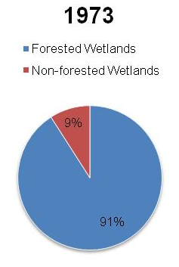
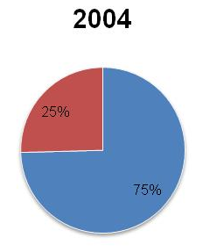
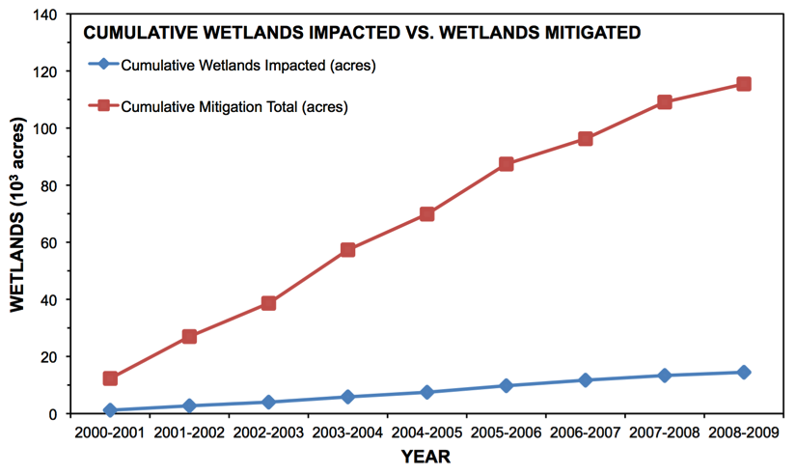
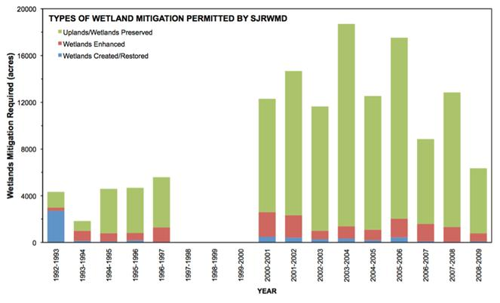
[
Aquatic Life
Wetlands
Results
  Shift to forested wetlands
  Impacted and mitigated wetlands increasing
  Mitigation mostly through preservation of upland species
  Hardwood swamps & transitional species are vulnerable to salinity and habitat changes, especially between Fuller Warren and Shands Bridges
INDICATOR | STATUS | TREND
Wetlands | Florida: Unsatisfactory LSJRB: Uncertain | Uncertain
Notes:
TREND
However, when examining a time series of Land Use/Land Cover maps from 1973 to 2004, there was a Notable shift over time from forested to non-forested wetlands.
From the records of wetland permits granted by the St. Johns River Water Mgmt District, the acres of wetlands impacted and mitigated have both increased.
The type of mitigation most commonly used has shifted from “wetlands creation and restoration” to “wetlands preservation.”
The total spatial extent of wetlands negatively impacted through the SJRWMD permit process is increasing each fiscal year. These impacts are magnified by the losses of wetlands permitted by the USACE (the evaluation of these Section 404 permits is limited in this study). Although not quantifiable from available databases, the two permitting processes might be leading to a cumulative, gradual loss of wetland ecosystem functions and services. If national trends hold true in Northeast Florida, coastal wetlands might be particularly vulnerable (Stedman and Dahl 2008). Additionally, the environmental consequences of the gradual shift from forested wetlands to non-forested wetlands require attention and further study.

Slide 18
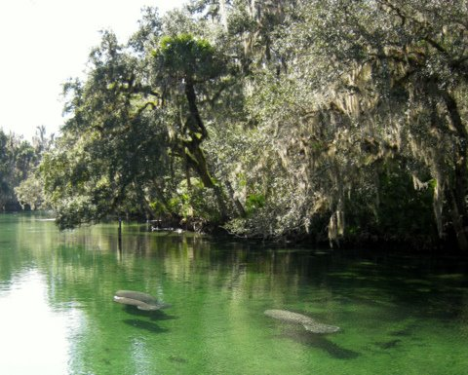
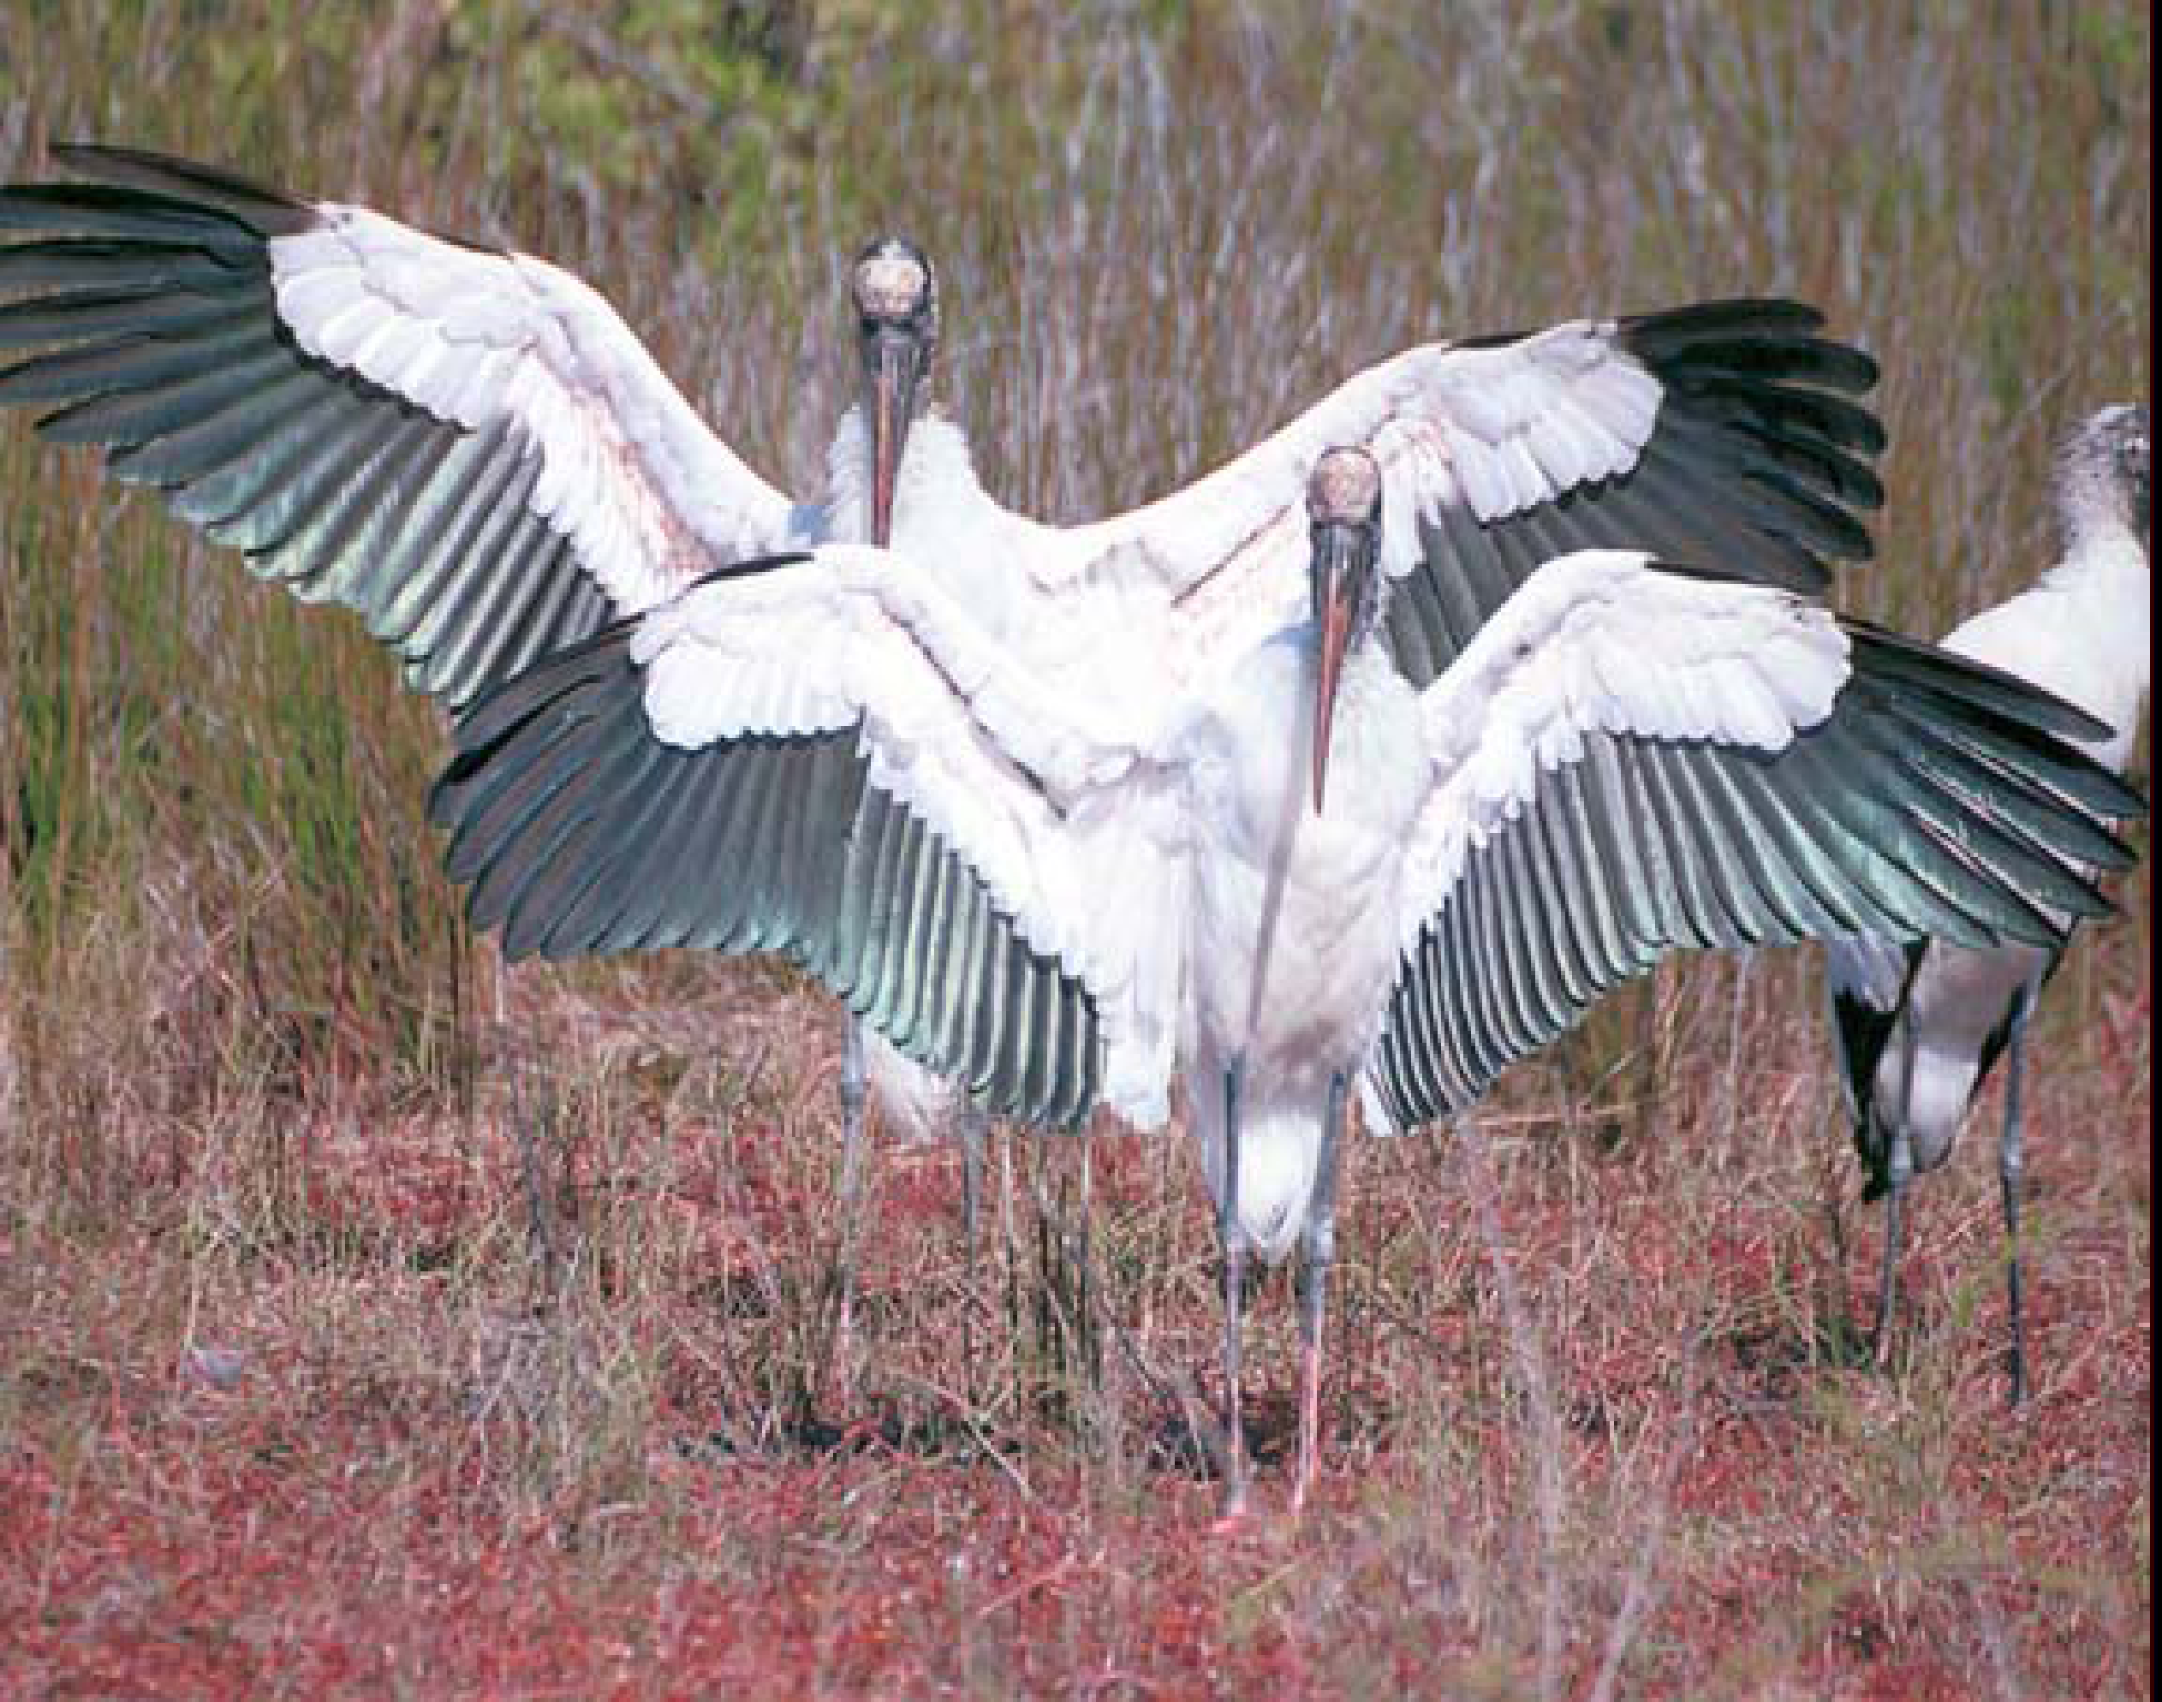
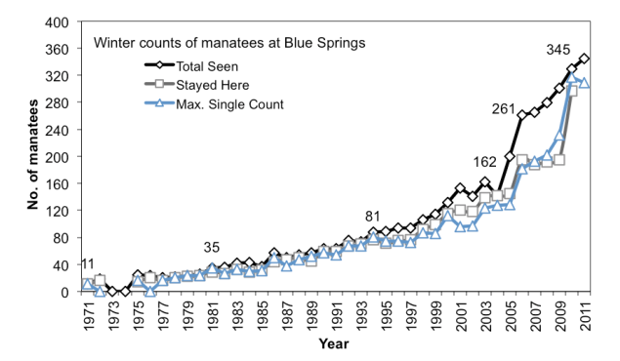
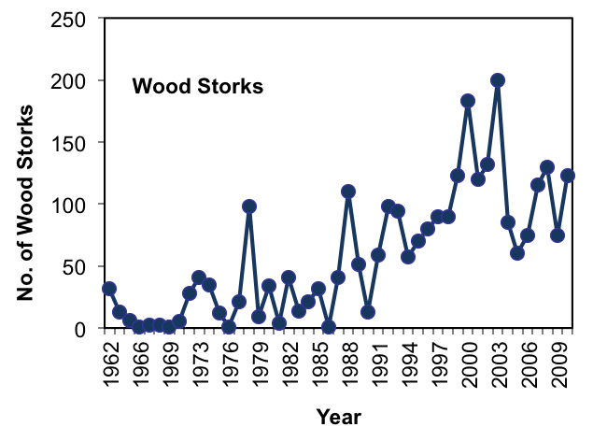
Aquatic Life
Federally Threatened
& Endangered Species
Gerry Pinto, Ph. D.
Jacksonville University
INDICATOR | STATUS | TREND
Florida manatee | Satisfactory | Atlantic sub-population: stable Blue Springs sub-population: improving
Bald eagle | Satisfactory | Improving
Wood storks | Satisfactory | Improving
Shortnose sturgeon | Satisfactory | Uncertain
Piping plover | Uncertain | Uncertain
Notes:
Uncertain if some Endangered Species populations are recovering or not (shortnose sturgeon, piping plover).
Threatened and endangered species, namely the Florida manatee, wood stork, shortnose sturgeon, piping plover, Florida scrub jay, and eastern indigo snake, continue to be vulnerable due to habitat loss, increased boating traffic, drought, and threats to SAVs.

Slide 19
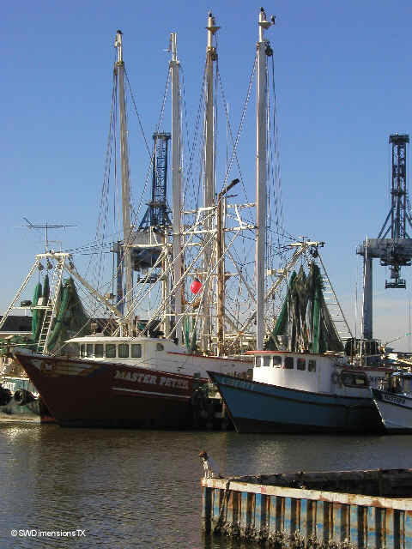
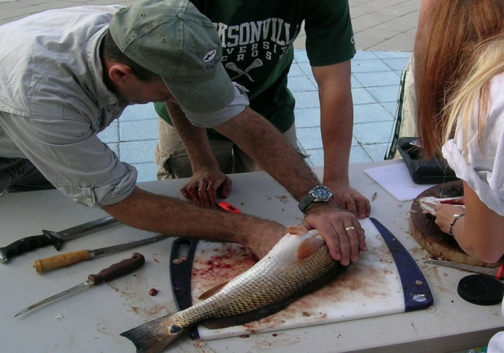
Fisheries
Dan McCarthy, Ph.D.
Jacksonville University
12 freshwater, estuarine and marine species
Three long-term data sets analyzed
  Fisheries Independent Monitoring data (FIMS) from FWRI (2001- 2011)
  Commercial landings for LSJR counties (FWRI) (1994 – 2011)
  Recreational landings for LSJR counties
Photo: A.Q. White
Notes:
The lower St. Johns River supports large commercial and recreational fisheries for both finfish and invertebrates. A number of these fisheries include freshwater & estuarine species.
In this study, three long-term data sets we analyzed to assess temporal changes in 12 important species. Data sets were tested for significant upward or downward trends using nonparametric statitistics.
These three data sets were…..
19

Slide 20
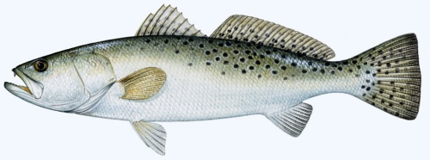
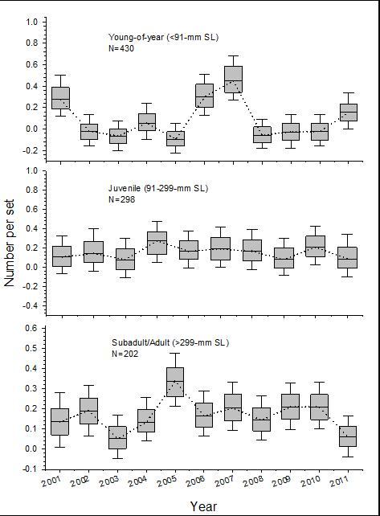
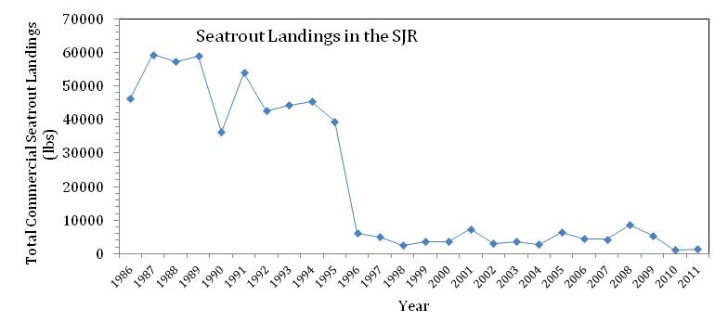
Fisheries
Spotted Seatrout
Cynoscion nebulosus
Three age classes caught in the LSJR 2001-2011
http://www.floridasportfishing.com/magazine/images
Commercial landings from 1986 to 2011
Note gill net ban in1995
Notes:
The lower St. Johns River supports large commercial and recreational fisheries for both finfish and invertebrates. A number of these fisheries include freshwater & estuarine species.
In this study, three long-term data sets we analyzed to assess temporal changes in 12 important species. Data sets were tested for significant upward or downward trends using nonparametric statitistics.
These three data sets were…..
20

Slide 21
Fisheries
INDICATOR | STATUS | TREND
Red drum | Satisfactory | Stable
Sheepshead | Satisfactory | Stable
Spotted seatrout | Satisfactory | Stable
Largemouth bass | Uncertain | Stable
Freshwater catfish | Uncertain | Conditions Worsening
Striped mullet | Satisfactory | Uncertain
Southern flounder | Uncertain | Uncertain
Stone crab | Satisfactory | Stable
Blue crab | Uncertain | Uncertain
Shrimp | Uncertain | Uncertain
Notes:
The lower St. Johns River supports large commercial and recreational fisheries for both finfish and invertebrates. A number of these fisheries include freshwater & estuarine species.
In this study, three long-term data sets we analyzed to assess temporal changes in 12 important species. Data sets were tested for significant upward or downward trends using nonparametric statitistics.
These three data sets were…..
21

Slide 22
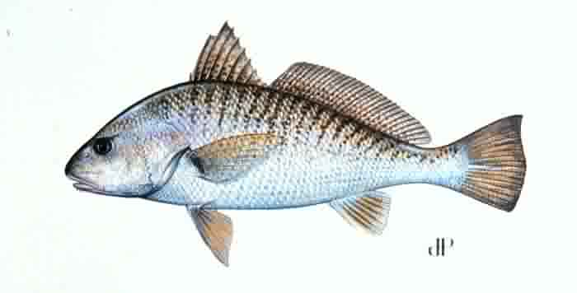
Fisheries
Finfish
  Many of the species in the LSJR today (~ 170 species total) were present in the 1960s
  Changes in salinity regimes may change their relative abundance in different zones of the river at different times
Atlantic Croaker
Micropogonias undulatus
://www.floridafishandhunt.com/.../atlcroaker.jpg
Notes:
The lower St. Johns River supports large commercial and recreational fisheries for both finfish and invertebrates. A number of these fisheries include freshwater & estuarine species.
In this study, three long-term data sets we analyzed to assess temporal changes in 12 important species. Data sets were tested for significant upward or downward trends using nonparametric statitistics.
These three data sets were…..
22

Slide 23
Macro-
invertebrates
Aquatic Life
Dan McCarthy, Ph.D.
Jacksonville University
Animals without a backbone that live on or in the sediment
Important part of the food web
Affect the aeration and sediment size of river bottom
Can signal river stress and pollution
Notes:
The next part of the report we will discuss is called Aquatic Life. The first section within this is Macroinvertebrates
Animals without a backbone that live on or in the sediment (including crabs, shrimp, snails, insects, worms, and barnacles).
Important part of the food web.
Affect the aeration and sediment size of river bottom.
Can signal river stress and pollution.

Slide 24
Aquatic Life
Macroinvertebrates
Generally degraded in many areas within the LSJRB
More pollution-tolerant species at main stem sites in fresher regions.
High environmental stress suggested in the Cedar-Ortega River Basin and Julington Creek organisms
INDICATOR | STATUS | TREND
Macrobenthic Invertebrates | Unsatisfactory | Uncertain
Notes:
Distribution of organisms depend on water quality, salinity, temperature

Slide 25

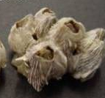

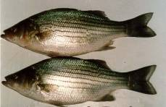
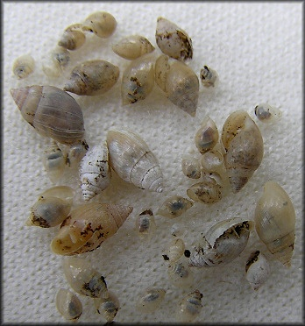

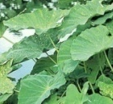


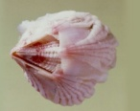

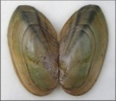
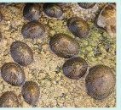
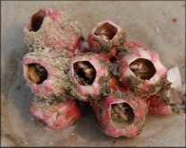
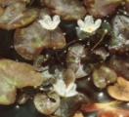
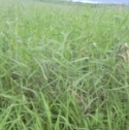
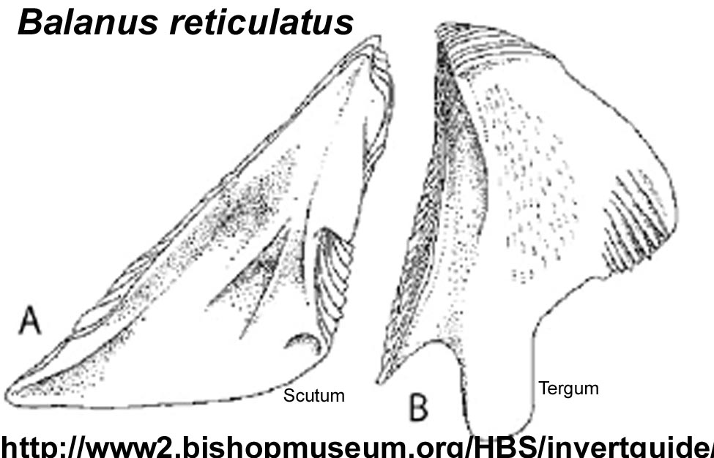
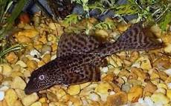

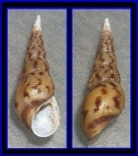
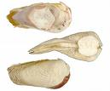

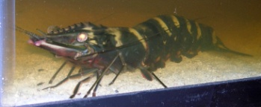






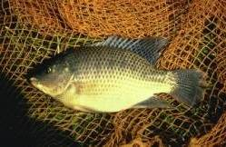
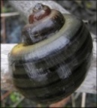

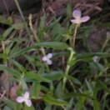
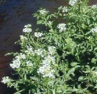


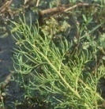
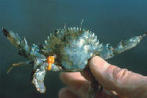
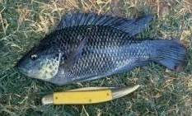

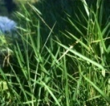
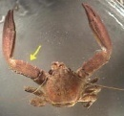
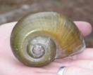




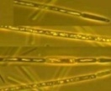


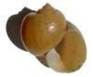




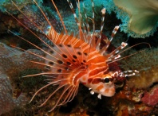

Aquatic Life
Non-native Aquatic Species
Heather McCarthy, M.E.M.
Jacksonville University
Notes:
One of the newer members on the list is the Asian tiger shrimp (Penaeus monodon) -- first sighted in the St. Johns River in 2008.
Now 61 species. Used to be 57

Slide 26
Aquatic Life
Non-native Aquatic Species
INDICATOR | STATUS | TREND
Non-native Aquatic Species | Unsatisfactory | Conditions worsening
Notes:
TREND
The cumulative number of non-native aquatic species introduced into the LSJRB has been increasing, since records were kept prior to 1900.
This trend is the reason that the category is assigned a CONDITIONS WORSENING status – indicating that non-native species are contributing to a declining status in the health of the St. Johns River Lower Basin.
The top two ways exotic species arrive in the Lower St. Johns River Basin:
Humans (through the accidental or intentional release of exotic pets, for example).
Foreign ballast water and sediment from ships.
Because both the number of humans and visiting ships are expected to increase, the rate of new introductions is expected to increase accordingly.
Thank you, and the next speaker is….

Slide 27

Contaminants
Lucinda Sonnenberg, Ph. D.
Jacksonville University
Releases into the LSJR environment: TRI
  Toxics Release Inventory (USEPA) Reports annual releases into air, water, and land by industries
Sediment concentrations and toxicity
  Four types of contaminants examined
  Concentrations compared to toxic effect levels for sediment organisms

Slide 28


Contaminants
TRI
  Releases to air
  Releases to water
Notes:
Reductions in air largely due to electrical utilities reductions of acid gases
Most surface water discharges are from USDOD, paper industry, electrical utilities
Gross trends do not address relative toxicity
PAHs and related compounds released into the air and water in the LSJR region between 2001 and 2010 has dropped. Several industries have shared in reducing the overall aromatic hydrocarbon loading to the region
Metals to atmosphere are declining largely by electrical utilities, metals to surface waters stable.
Both atmospheric and SW discharges of mercury have declined, mainly due to electrical utilitites

Slide 29

Contaminants
Toxicity of different chemicals to benthic organisms in different regions of the river
  Western tribs sediments worst for sediment organisms
  North arm of river has PAH contamination
  Improving conditions as move upstream

Slide 30
Contaminants
INDICATOR | STATUS | TREND
Chemical Releases (TRI) | Air – Unsatisfactory Water - Uncertain | Air – Improving Water - Stable
Polyaromatic Hydrocarbons (PAHs) | Unsatisfactory | NORTHERN LSJRB – Improving SOUTHERN LSJRB - Uncertain
Metals | Unsatisfactory | Stable
Polychlorinated Biphenyls (PCBs) | Unsatisfactory | Stable
Pesticides with Chlorine | Unsatisfactory | Stable

Slide 31
The Future
Continue the report each year
5-Year Plan
  How can we best serve the community?
  Content and direction of the River Report for the next 5 years
Notes:
The St. Johns River is a wonderful resource that defines our region of Florida.
Future plans….
Ways of improving
Expanding to entire river
….to help public understand the ecology and attemps to help preserve this wonderful resource.
On behalf of all the JU-UNF Team Members, I thank you for your attention and interest.

Slide 32

Thank you.

